Slide 1
Contextual ontologies
Sources:
Klarman, S., & Gutiérrez-Basulto, V. (2011).
Two-Dimensional Description Logics for Context-Based Semantic Interoperability. In Proc. Twenty-Fifth AAAI Conference on Artificial Intelligence.
Aljalbout S., Buchs D., Falquet G. (2019) Introducing Contextual Reasoning to the Semantic Web with OWL𝐶. In Proc. Intl Conf. on Conceptual Structures - Graph-Based Representation and Reasoning. ICCS 2019. Lecture Notes in Computer Science, vol 11530. Springer.
G. Falquet

Slide 2
e.g. semantic indexing of texts
DL
[...]
Description Logics (DLs) are popular knowledge representation formalisms, whose most prominent application is the design of ontologies
[...]
Under the standard Kripkean semantics, a DL ontology forces a unique, global view on the represented world, in which the ontology axioms are interpreted as universally true.
application
Design of
Ontologies
forces [?]
Unique global
view

Slide 3
McCarthy theory of contexts
replace logical formulas φ, as the basic knowledge carriers, with
ist(c,φ) stating that φ is true in c,

Slide 4
Postulates
1. Contexts are formal objects.
anything that can be denoted by a first-order term
2. Contexts have properties and can be described.
allows ∀x(C(x) → ist (x, φ)), expressing that φ is true in every context of type C .
3. Contexts are organized in relational structures.
contexts are often accessed from other contexts. Formally, this can be captured by allowing nestings of the form ist(c, ist(d, φ)).

Slide 5
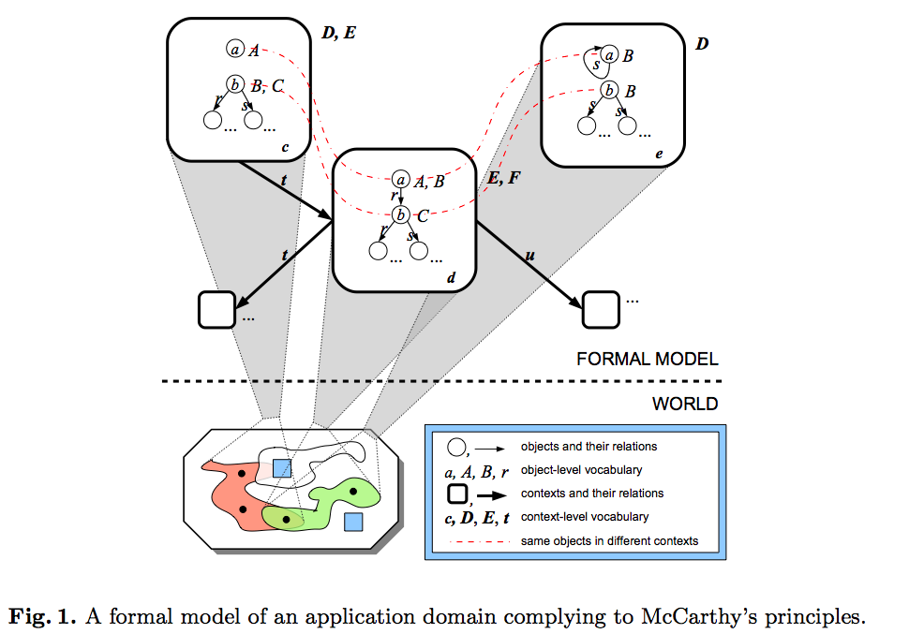

Slide 6
Description Logic of Context
A Description Logic of Context C(LC,LO) consists of
a DL context language LC supporting context descriptions
an object language LO equipped with context operators for representing object knowledge relative to contexts.
The context language is a DL language LC over the vocabulary Γ = (M_{C} , M_{R} , M_{I} ), (concepts, roles, individuals)
with a designated subset M_{I}⋆ ⊆ M_{I} (the context names) .

Slide 7
Object language
The object language of C(LC, LO) is the smallest language containing LO and closed under the constructors of LO and one of the two types of concept-forming operators:
⟨r.C⟩ D | [r.C] D (F1)
⟨C⟩D | [C]D (F2)
where C is a concept and r a role of the context language and D is a concept of the object language.

Slide 8
Meaning of the contextual expressions
⟨C⟩ D
all objects which are D in some context of type C,
[C] D
all objects which are D in every such context.
⟨r.C⟩ D
all objects which are D in some context of type C accessible from the current one through r.
[r.C] D
all objects which are D in every such context.

Slide 9
⟨EuropeanCountry⟩ Citizen
The concept Citizen in some context of type EuropeanCountry.
⟨neighbor.Country⟩ Citizen
The concept Citizen in some context of type Country accessible through the neighbor relation from the current context.

Slide 10
Knowledge base
A knowledge base is a pair K = (C, O), where
C is a set of axioms of the context language
O is a set of formulas of the form:
c:φ | C:φ
where
φ is an axiom of the object language (subClass, instance, role axiom)
c ∈ M_{I}⋆ (a context)
C is a concept of the context language. (a context class)

Slide 11
meaning of the assertions
c : φ states that the axiom φ holds in the context denoted by the name c.
1969 : CanVote ⊑ Aged21orMor
1857 : Professor(Saussure)
California : LegalForRecreationalUse(cannabis)

Slide 12
meaning of the assertions
C : φ assert the truth of φ in all contexts of type C
EUCountry : Prohibited(remote_biometric_identification)
in every EU country remote biometric identification is prohibited.
Country : ⟨neighbor.Country⟩Citizen ⊑ NoVisaRequirement
in every Country a person who is a citizen in some neighboring country does not need a visa

Slide 13
formal interpretation of the language
In standard DL an interpretation is made of
a domain
an interpretation function .^{I} for concepts, properties, and individuals
C → C^{I}, R → R^{I}, o → o^{I}
In a contextual DL an interpretation is made of
a contextual domain C
for each context i in C
an interpretation function .^{I[i]} for concepts, properties, and individuals
C → C^{I[a]}, C^{I[b]} , C^{I[c]} , ...

Slide 14
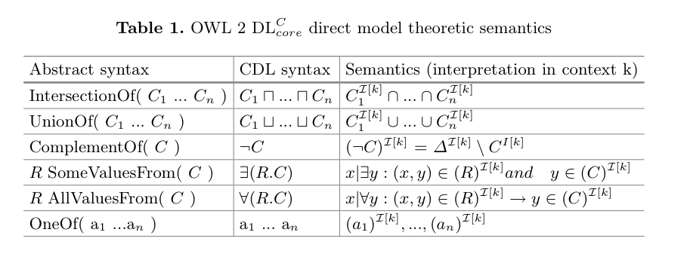
Contextual interpretation

Slide 15
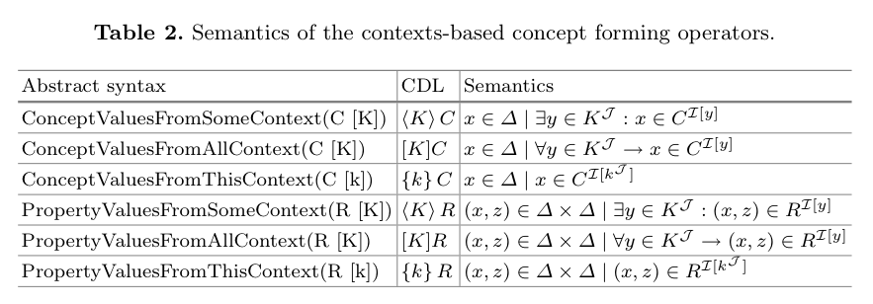

Slide 16
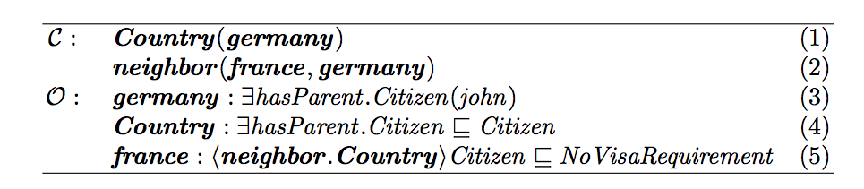
Example: geographic context
consequence: john is an instance of NoVisaRequirement

Slide 17
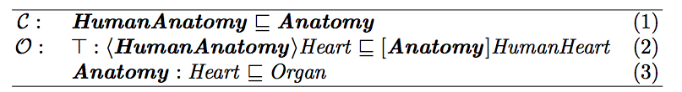
Example: context = ontology
An ontology of human anatomy is an ontology of anatomy
In any ontology the concept HumanHeart corresponds to the concept Heart in an ontology of the human anatomy
In every anatomical ontology the heart is an organ

Slide 18
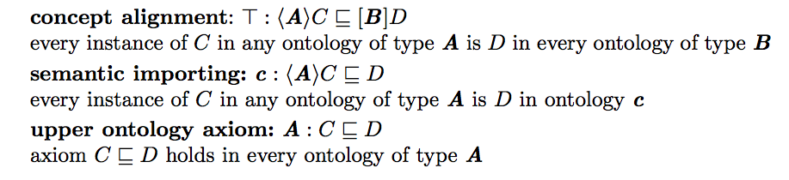
Example: Describing alignments

Slide 19
Implementation on the SW
representing individual axioms
representing class/role axioms
reasoning rules
extension to context sets

Slide 20
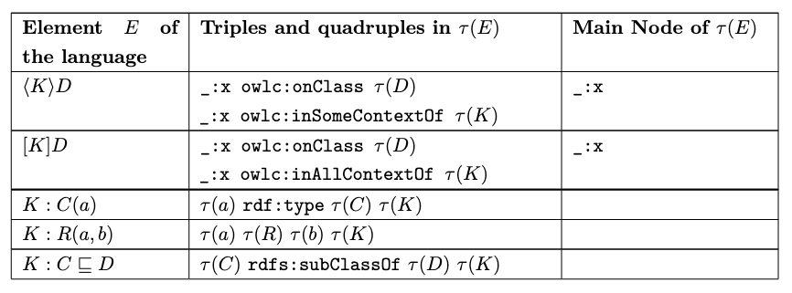

Slide 21
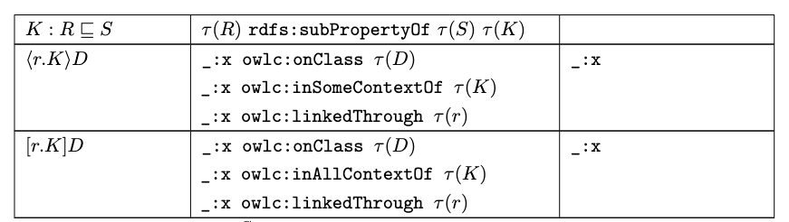

Slide 22
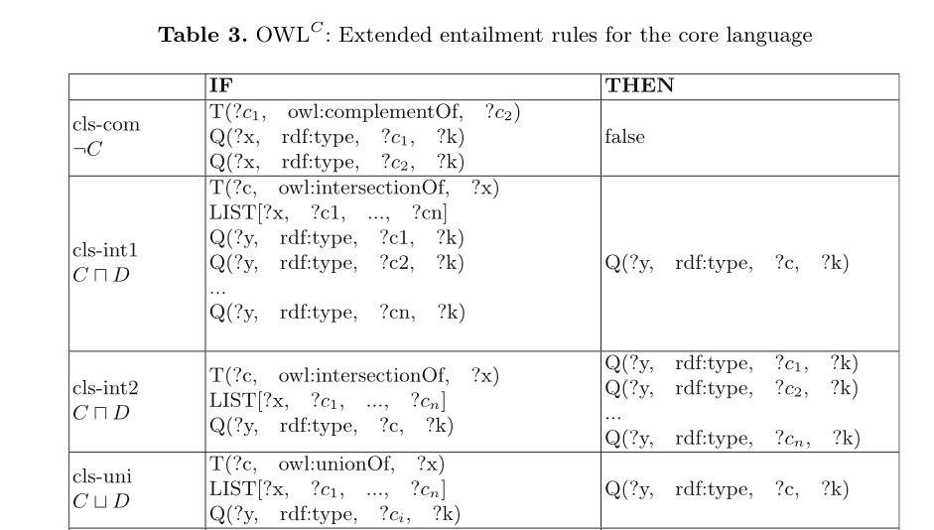
Adaptation of the OWL2 RL Rules

Slide 23
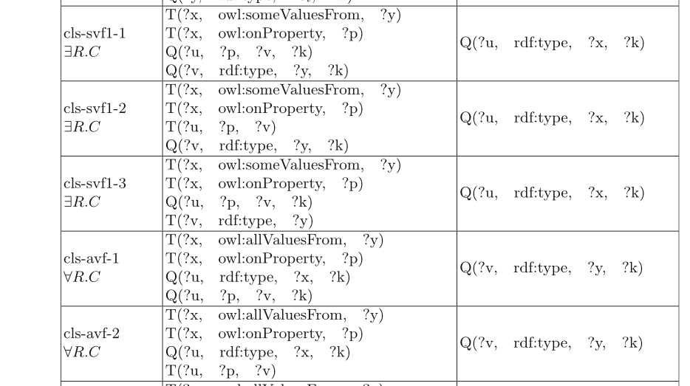

Slide 24
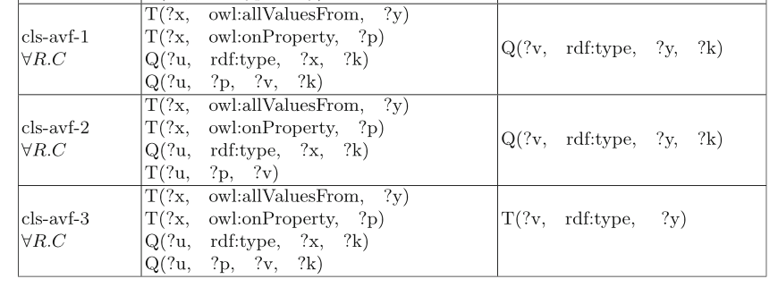

Slide 25
